Slide 1


Organizational Behavior
(MGT-502)
Lecture-18

Slide 2
Summary of
Lecture-17

Slide 3
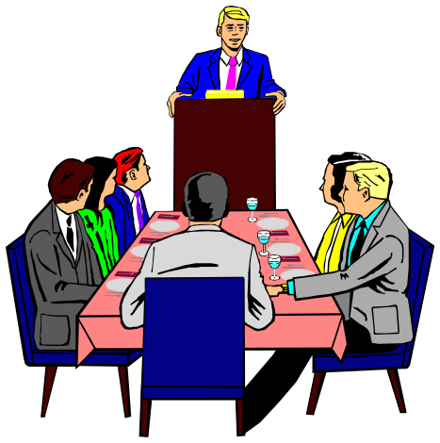
Groups Defined
Two or more individuals interacting with each other in order to accomplish a common goal.

Slide 4
Stages of Group Development
Forming
Storming
Norming
Performing
Adjorning

Slide 5
Group Roles
Task-Oriented
Roles:
Initiators
Information Seekers
Opinion Givers
Energizers
Relations-
Oriented Roles:
Harmonizers
Compromisers
Encouragers
Expediters
+
Task
Performance
+
-
Self-Oriented
Roles:
Blockers
Recognition Seekers
Dominators
Avoiders

Slide 6
Relationship Between Cohesiveness, Norms, & Productivity
Cohesiveness
High Low
High
Low
High
productivity
Moderate
productivity
Performance Norms
Low
productivity
Moderate to
low productivity

Slide 7
Today’s Topics

Slide 8
Increasing Group Productivity
Reduce the size of the group
Increase group member motivation
Increase group cohesiveness and productivity norms
Match the group’s communication structure to the task complexity
Notes:
11/1/01
13

Slide 9
Characteristics of a
Well-Functioning, Effective Group
Relaxed, comfortable, informal atmosphere
Task well understood & accepted
Members listen well & participate
People express feelings & ideas
Notes:
3

Slide 10
Conflict & disagreement center
around ideas or methods
Group aware of its operation & function
Consensus decision making
Clear assignments made & accepted
Notes:
3

Slide 11
Conducting a Group Meeting
Follow these 12 steps to more efficient and effective meetings:
Prepare a meeting agenda.
Distribute the agenda in advance.
Consult with participants before the meeting.
Get participants to go over the agenda.
Establish specific time parameters.
Maintain focused discussion.
Encourage and support participation of all members.
Maintain a balanced style.
Encourage the clash of ideas.
Discourage the clash of personalities.
Be an effective listener.
Bring proper closure.
Notes:
This material is found on page 169.

Slide 12


Teams

Slide 13

Teams
Teams are groups with greater interdependence--shared purpose and destiny. Can be higher performing than groups, but may not be...

Slide 14
Why Have Teams Become So Popular
Teams typically outperform individuals.
Teams use employee talents better.
Teams are more flexible and responsive to changes in the environment.
Teams facilitate employee involvement.
Teams are an effective way to increase motivation.

Slide 15
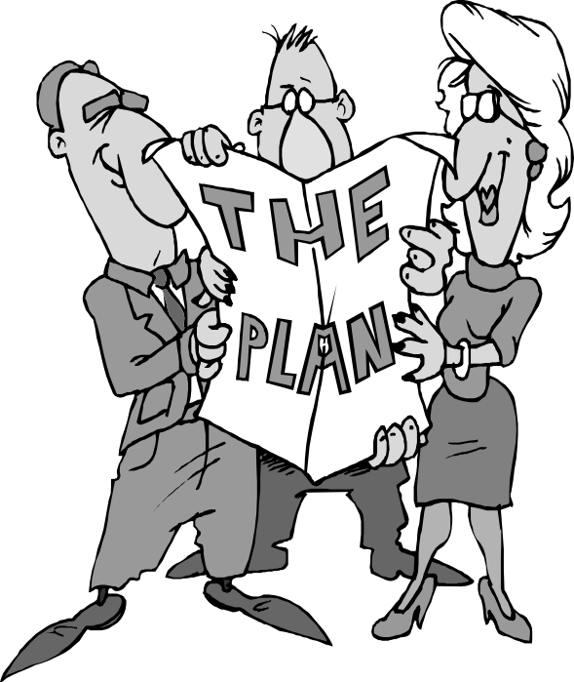
Formal groups made up
of interdependent individuals, responsible for attaining a goal

Slide 16
“It’s easy to get
players. Gettin’
‘em to play
together, that’s the hard part.”
Casey Stengel

Slide 17
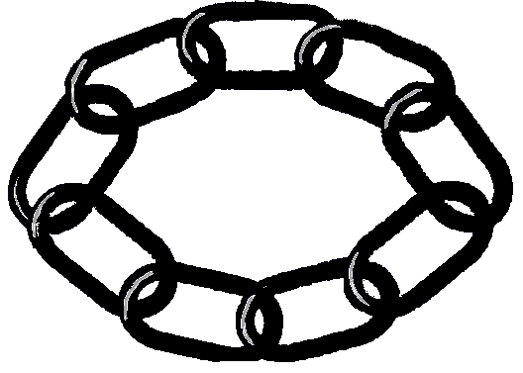

Clearly Stated Objectives
Real &
Symbolic
Needs
Successes
Reinforce
Commitment
Strength
Though
Adversity
Diverse Objectives
Linked by A
Common Purpose
Mutually
Supportive
Notes:
56

Slide 18
Characteristics of Effective Teams
Atmosphere and relationships
Member participation
Goal understanding & acceptance
Listening and sharing information
Handling conflicts and disagreements
Decision making

Slide 19
Evaluation and member performance
Expressing feelings
Division of labor
Leadership
Attention to process

Slide 20

High Performance Teams
Char’s
Strong core values
Specific performance objectives
Right mix of skills
Creativity

Slide 21
Factors Affecting Teams
Work Design
Team Composition
Context
Process

Slide 22
Work Design
Autonomy
Task
Feedback

Slide 23
Composition
Ability
Personality
Roles
Size
Flexibility
Preference for Teams

Slide 24
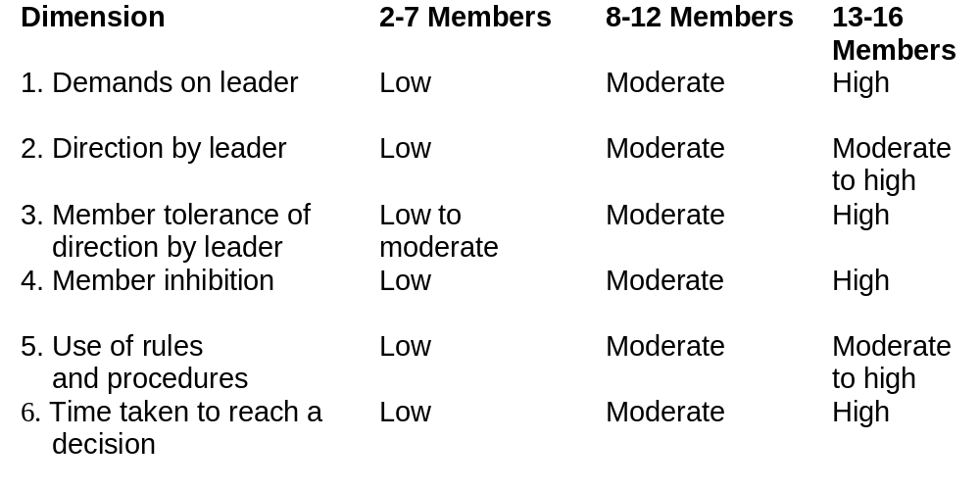
Typical Effects of Size on Teams
TEAM SIZE

Slide 25
Context
Resources
Leadership
Performance evaluation and rewards

Slide 26
Process
Common purpose
Specific goals
Team efficacy
Conflict management
Avoid social loafing

Slide 27
Why Teams?
Teams better utilize employee talents
Teams are more flexible and responsive
Teams are easy to assemble, deploy, refocus, and disband
Teams facilitate employee participation
Teams increase employee motivation

Slide 28
Why Teams?
Good when performing complicated, complex, inter-related and/or more voluminous work than one person can handle
Good when knowledge, talent, skills, & abilities are dispersed across organizational members
Empowerment & collaboration; not power & competition
Notes:
11/1/01
19

Slide 29
Teamwork Processes
Common
Purpose
Specific
Goals
Efficacy
Social
Loafing
Conflict

Slide 30





Problem-
Solving
Self-
Managed
Types of
Teams
Virtual
Cross-
Functional

Slide 31
Three types of Teams
Problem
Solving
Self-
Managed
Cross
Functional

Slide 32
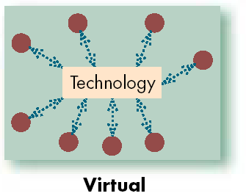
Types of Teams

Slide 33
Stages of Team Development
Performing
Norming
Storming
Existing teams might regress back to an earlier stage of development
Forming
Adjourning

Slide 34
Team Roles
Task-Oriented
Roles:
Initiators
Information Seekers
Opinion Givers
Energizers
Relations-
Oriented Roles:
Harmonizers
Compromisers
Encouragers
Expediters
+
Task
Performance
+
-
Self-Oriented
Roles:
Blockers
Recognition Seekers
Dominators
Avoiders

Slide 35
Turning Individuals Into Team Players
The Challenges
  Overcoming individual resistance to team membership.
  Countering the influence of individualistic cultures.
  Introducing teams in an organization that has historically valued individual achievement.
Shaping Team Players
  Selecting employees who can fulfill their team roles.
  Training employees to become team players.
  Reworking the reward system to encourage cooperative efforts while continuing to recognize individual contributions.

Slide 36
Turning Individuals
Into Team Players
Selection
Training
Rewards

Slide 37
Building Effective Teams
Building Team
Spirit
Understanding
Polarization
Choosing Team
Size and
Membership
Effective
Teams
Developing
Productive Norms
Encouraging
Effective Team-
Member Roles
Planning the
Team Effort
Defining the Team’s
Assignment

Slide 38
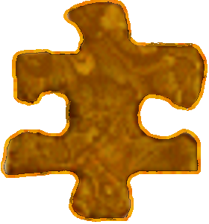

T
E
A
M
ogether
veryone
chieves
ore

Slide 39
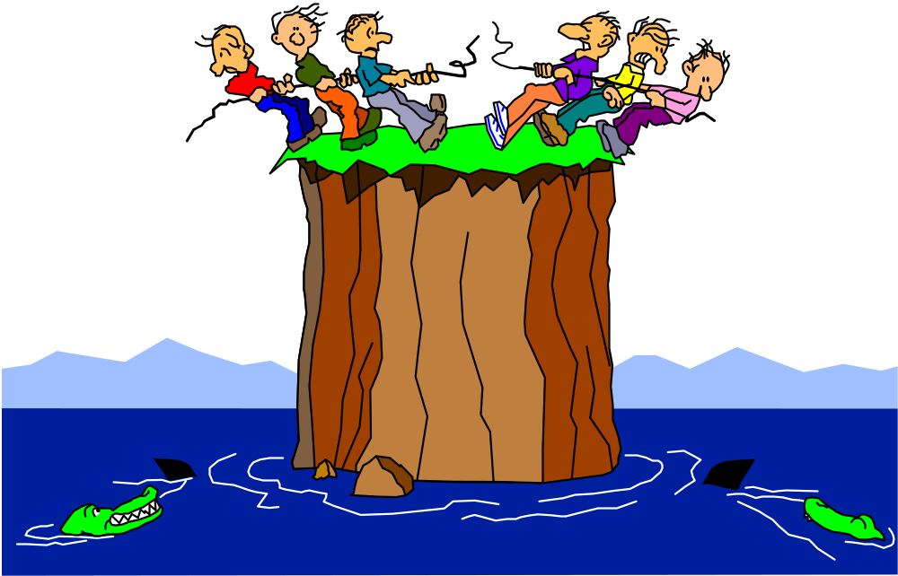
Conflicts Among Teams

Slide 40

Let’s stop it here

Slide 41
Summary

Slide 42
Teams

Slide 43
Clearly Stated Objectives
Real &
Symbolic
Needs
Successes
Reinforce
Commitment
Strength
Though
Adversity
Diverse Objectives
Linked by A
Common Purpose
Mutually
Supportive
Notes:
56

Slide 44
High Performance Teams
Char’s
Strong core values
Specific performance objectives
Right mix of skills
Creativity

Slide 45
Factors Affecting Teams
Work Design
Team Composition
Context
Process

Slide 46
Problem-
Solving
Self-
Managed
Types of
Teams
Virtual
Cross-
Functional

Slide 47
Turning Individuals
Into Team Players
Selection
Training
Rewards

Slide 48
Next….

Slide 49
Organizational Behavior
(MGT-502)
Lecture-18

